Slide 1
PRTR in Japan
Masami Kittaka
May 1, 2013
STRIPE at Jakarta

Slide 2
History (PRTR in Japan)
1996 OECD recommendation on PRTR implementation
1998 PRTR Pilot project (2000 facilities in 30 cities (5%))
2001 “PRTR Law” enforced
with an additional resolution of review
after seven years
2003 First disclosure of PRTR data
2008 Revision of the Law

Slide 3
Scope of Reporting
1. Substances --- Class I substances
435 substances (Before 2008)
562 substances (Current)
Class I Designated Chemical Substance
(354 substances)
Class I Designated Chemical Substance
(462 substances)
Specified Class I Designated Chemical Substance
(12 substances)
Specified Class I Designated Chemical Substance
(15 substances)
Class II Designated Chemical Substance
(81 substances)
Class II Designated Chemical Substance
(100 substances)
2. Business operators with reporting duty
Excluded 85 substances
Kinds of business
Manufacturing, energy, cleaning, and etc.
Number of employees
More than 21 regular employees
Handling amounts
More than 1 ton per year
2003
2004
2005
2006
2007
2008
2009
2010
Reporting Biz Operators
Reported Substances

Slide 4
Overview on PRTR in Japan
Targeted Business operators
Others
report
estimate
Non-targeted business
Non-targeted industry
Less than 21 employees
Smaller handing amounts
Household
Automobiles, etc.
Local government
via
National government
compiled data
Individual data
Compile
Publication of compiled data
Disclosure of Individual data on demand
Local government
Request of
Individual data
Publication of regionally compiled data
Disclosure of Individual data by web
(2009~)
Citizens

Slide 5
Target Business Categories
Other Business Categories
Household
Businesses not subject to report
Agrichemical
Businesses subject to reporting
Adhesive bonds
Number of payrolls not over 20, less than 1t
Paints
Number of payrolls 21 or more, Manufacturing 1t or more of a specified substance annually, (5t for the first 2-year)
Detergent
Substances contained very low
in products
Drugs
Cosmetic
Antifoulant agent
Insecticide,
Deodorant
Sewage treatment plant
Trihalomethane in drinking water
Ozone-layer depleting Chemicals/Dioxins
Movable Bodies
Automobiles, bikes, special automobiles (for industry, construction, agriculture) Boats and ships (including freighter, passenger ships, and fishing ships), Railroad vehicles, Aircraft.
Chart made by Ministry of Environment

Slide 6
Characteristics of PRTR in Japan
Objective of “PRTR law”
To promote voluntary reduction of chemical substances by business operators.
No word referring to “right to know”
No word referring to “ aim to reduce the release”
Wide range of reporting substances
Estimate by the national government for smaller business and non-reported sources
Statistics, questionnaires, development of models
Reporting via local governments to the national government
No claim for “business secret” by now.

Slide 7
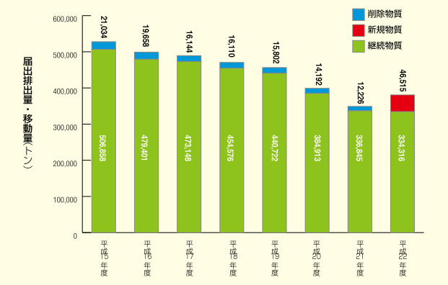
PRTR reported data
Excluded substance
New substance
Continuing substance
Transferred and Released
Amount (t0n)
2003 2004 2005 2006 2007 2008 2009 2010
( Fiscal Year)

Slide 8
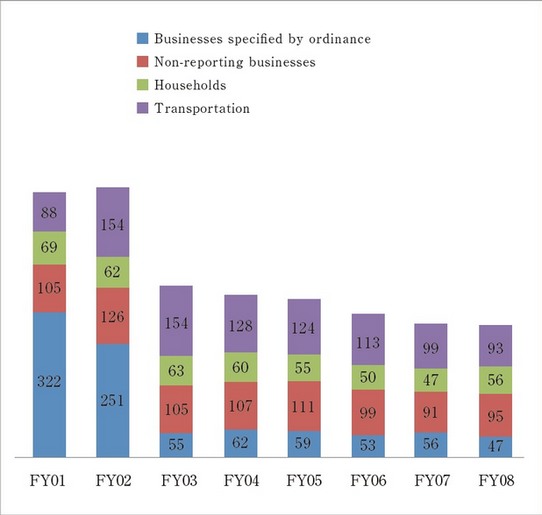
Annual Estimated Releases Outside Reporting
Unit: Thousand tons

Slide 9
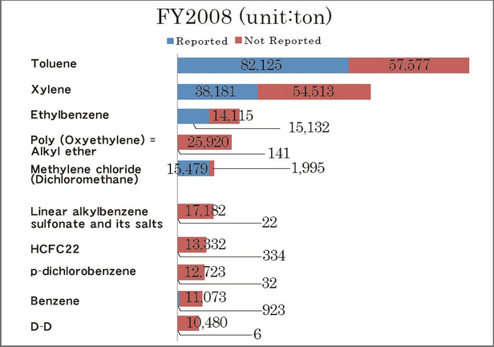
Top 10 substances by release quantities

Slide 10
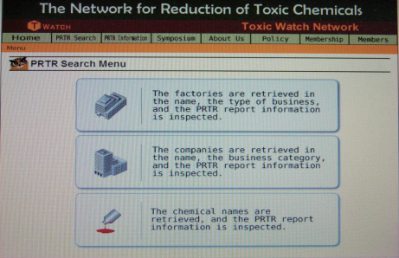
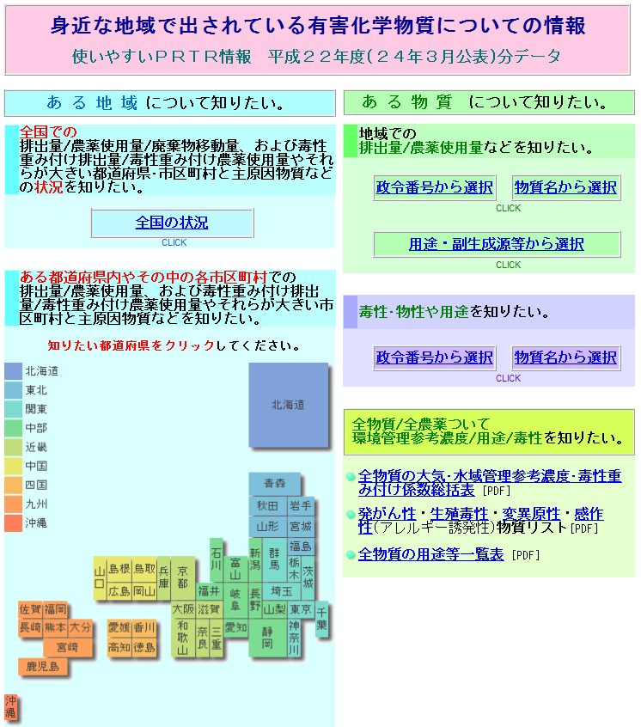
NGOs to promote PRTR data use
Toxic Watch (T Watch)
Providing Database on Internet
http://toxwatch.net/en/
Hosting study meetings all over Japan
Organization for Research and Communication
on Environmental Risk of Chemicals (Eco-Chemi)
Operated by academic researchers
Prioritization with risks
http://www.ecochemi.jp/PRTR.html

Slide 11
2008 PRTR law revision
Active dissemination of data by the national government
Previous: Disclosure of individual data based on request for 1,090 yen
Current : Disclosure on website for free of charge
Review of the listed industries and designated substances
Expanding the scope from 354 to 462 substances.
Further calculations for Estimated Releases Outside Notification
Increase the number of substances covered by estimation for the substances released from sewage treatment and waste incinerators

Slide 12
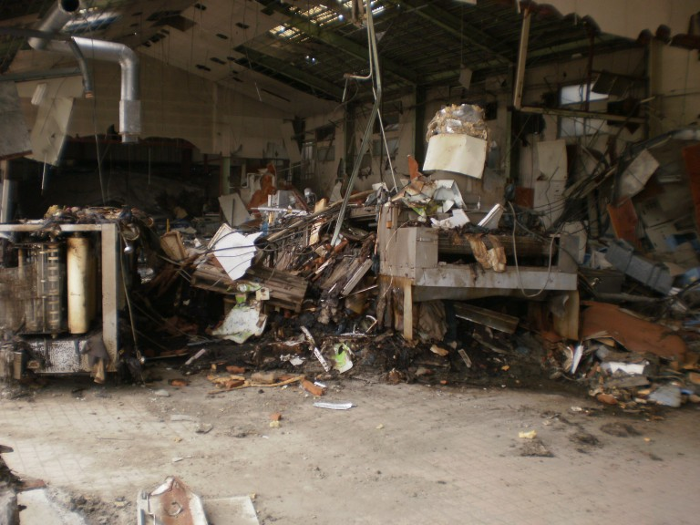
Great East Japan Earthquake and PRTR
March 11, 2011
364 business operators seemed to be damaged. (By T Watch’s investigation)
MoE investigation
Lost PCB transformer: 1 unit, Lost PCB condenser: 45 units
-> Not detected in soil by T Watch’s investigation
PRTR data in “Designated Disaster Area” (By MoE report)
4,572 business operations reported. (4% reduction)
40,761 tons （Released 20,214 tons + Transferred 20,547 tons, 6 % reduction)
The amount and kinds of chemical substance
released were undetectable.

Slide 13
Issues for improvement
Report the handling amounts and/or the maximum storage amounts of waste or used chemicals
Some local government can obtain the information based on their own ordinance.
National government is reluctant because of the purpose of the law.
No use of data by citizens
Better information disclosure by the government
Efforts
Combination of night view factory tours and risk communication
Environmental dialogue
Accuracy of estimation
Strengthening the role of local government
Failure of reporting duty
The government does not use the data for making policy

Slide 14
PRTR Substances = Substances on Label?
MOE started including the list of substances from 2010 date book for citizens (issued in March 2013).
Pesticides
Insecticides
Detergents
Cosmetics
Insect repellent
EXAMPLE:
PRTR substances name: 1,1'-Dimethyl-4,4'-bipyridinium Dichloride 1910-42-5
Substance on a product label: Paraquat

Slide 15
Thank you!
Masami Kittaka
Masami.Kittaka@gmail.com

